Slide 1





Complete Selenium Automation Engineer Bootcamp: Go from Zero to Hero

Slide 2
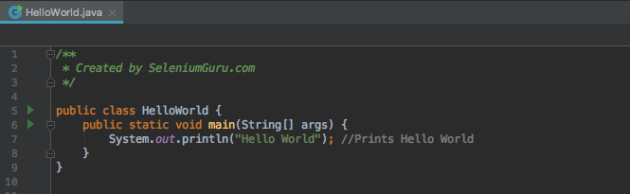
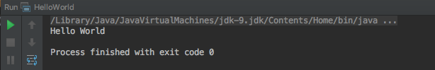
Hello World

Slide 3
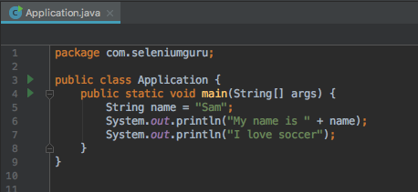
String
String is an object typically representing sequence of characters.
The java.lang.String class is used to create string object.
String are always in double quotes.

Slide 4
Primitive Data Types
Java have basically eight primitive data types.
Byte - The byte data type is an 8-bit signed two's complement integer. It has a minimum value of -128 and a maximum value of 127. The byte data type can be useful for saving memory in large arrays, where the memory savings actually matters.
Short - The short data type is a 16-bit signed two's complement integer. It has a minimum value of -32,768 and a maximum value of 32,767. You can use a short to save memory in large arrays, in situations where the memory savings actually matters.
Int – 2-bit signed two's complement integer, which has a minimum value of -2³¹and a maximum value of 2³¹-1. Int data type is normally used in Java to support arithmetic operation for integers.

Slide 5
Primitive Data Types
Long- The long data type is a 64-bit two's complement integer. The signed long has a minimum value of -2⁶³ and a maximum value of 2⁶³-1. Use this data type when you need a range of values wider than those provided by int.
Float- Float data type is a single-precision 32-bit floating integers. As with the recommendations for byte and short, use a float (instead of double) if you need to save memory in large arrays of floating point numbers.
Double– The double data type is a double-precision 64-bit floating point. For decimal values, this data type is generally the default choice.
Boolean: The boolean data type has only two possible values: true and false. Use this data type for simple flags that track true/false conditions.
Char - The char data type is a single 16-bit Unicode character. It has a minimum value of '\u0000' (or 0) and a maximum value of '\uffff’. Char should be always in single quote.

Slide 6
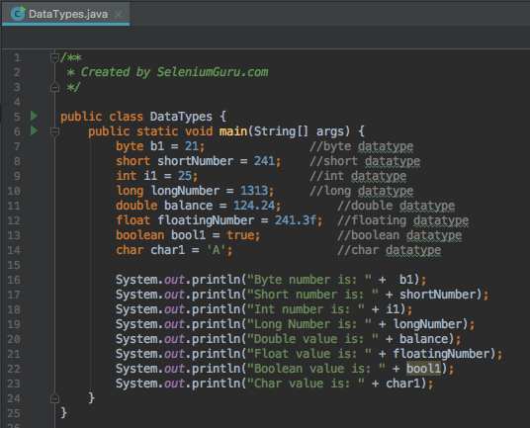
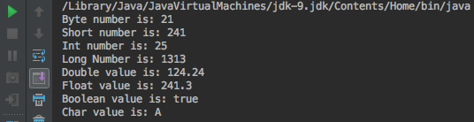
Data Types

Slide 7
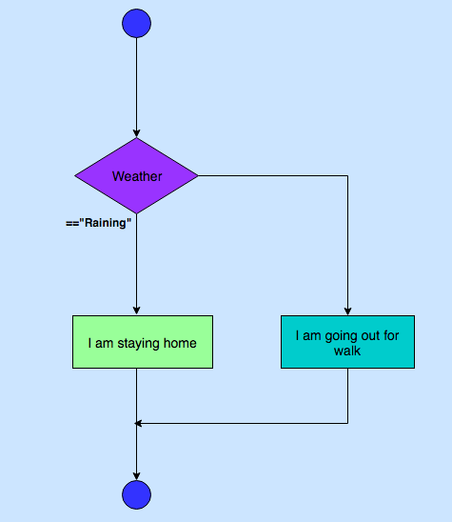
Conditional Execution – If-else

Slide 8
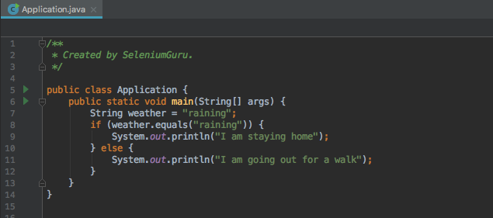
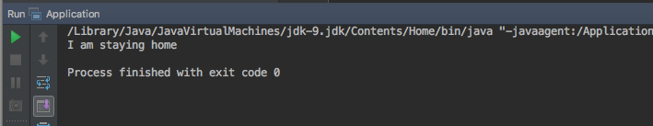
Conditional Execution – If-else

Slide 9
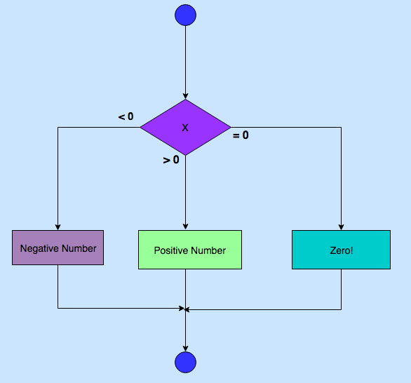
Conditional Execution – If - else if- else

Slide 10
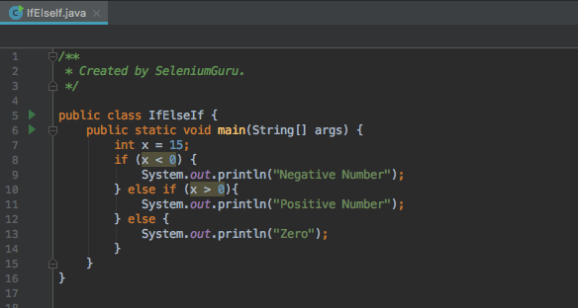
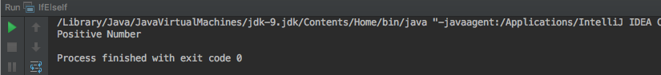
Conditional Execution – If-else-If

Slide 11
Conditional Expressions
 | Condition1 | Condition2 | Result
&& | True | True | True
&& | True | False | False
&& | False | True | False
||(OR) | True | False | True
||(OR) | False | True | True
== | Equal to
!= | Not Equal to

Slide 12
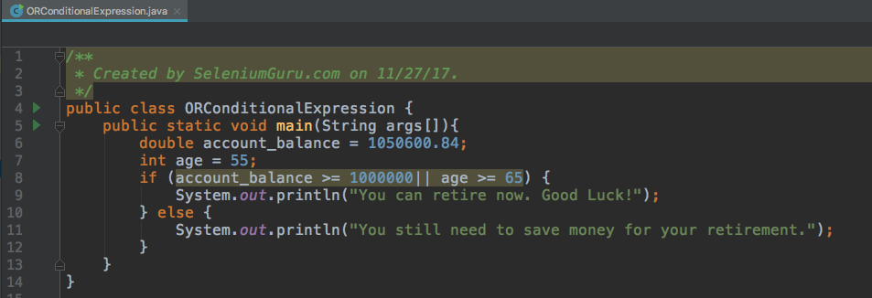
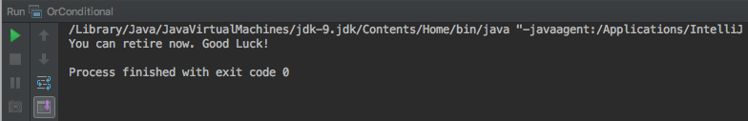
Conditional Expressions

Slide 13
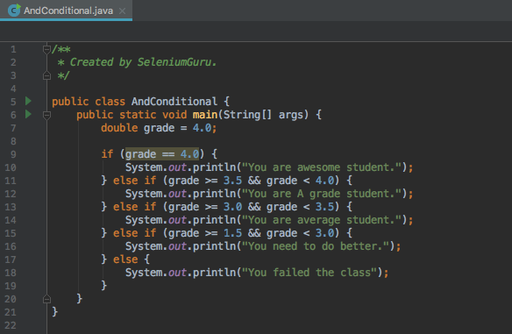
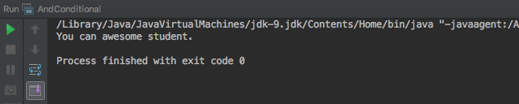
Conditional Expressions

Slide 14
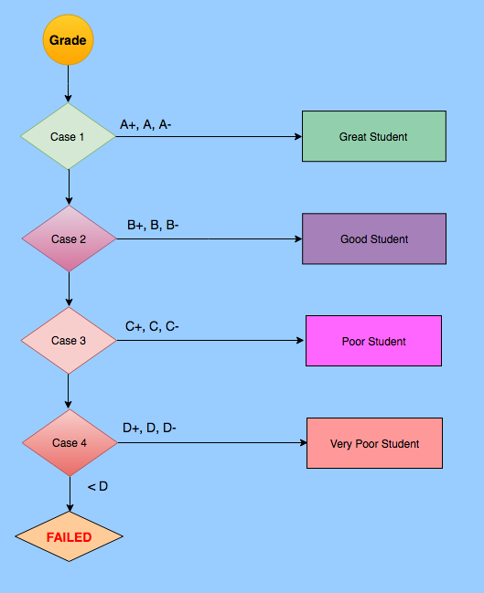
Conditional Execution – Case(Switch)

Slide 15
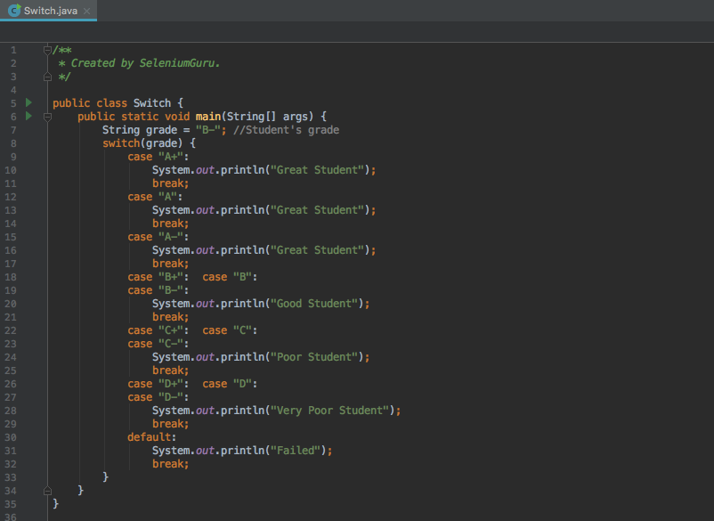
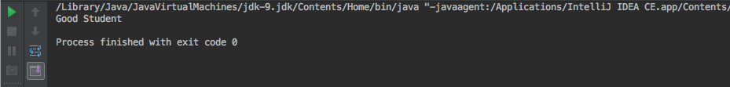
Switch

Slide 16
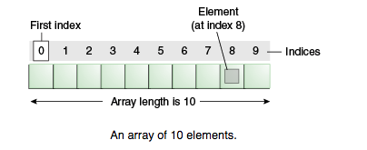
Array
Arrays are ordered, integer-indexed collections of any object.
Arrays are always in curly brackets {}.
Arrays indexing starts at 0 just like in C or Ruby.

Slide 17
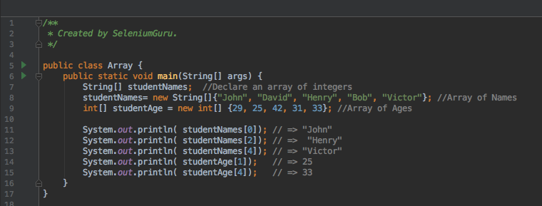
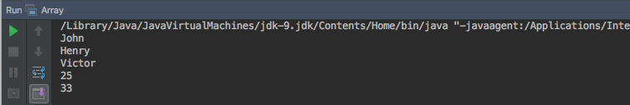
Arrays

Slide 18
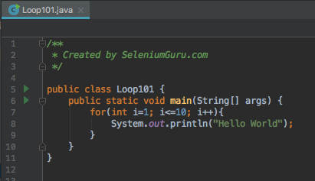
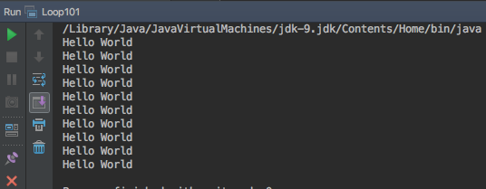
Looping
A loop is a sequence of instructions that is continually repeated until a certain condition is reached.
Looping is used to iterate over the range of number, text, array elements and so on..
Problem: Print “Hello World”10 times.
Without Loop
System.out.println("Hello World"); System.out.println("Hello World"); System.out.println("Hello World"); System.out.println("Hello World"); System.out.println("Hello World"); System.out.println("Hello World"); System.out.println("Hello World"); System.out.println("Hello World"); System.out.println("Hello World"); System.out.println("Hello World");

Slide 19
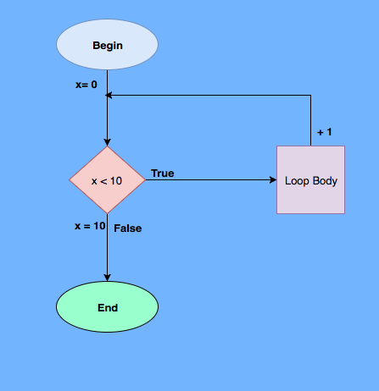
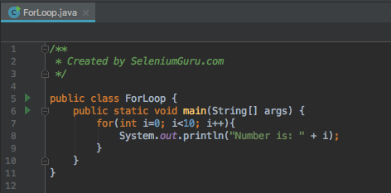
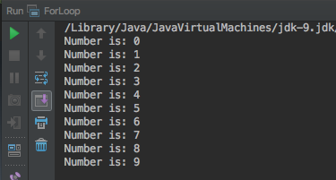
Looping – For Loop

Slide 20
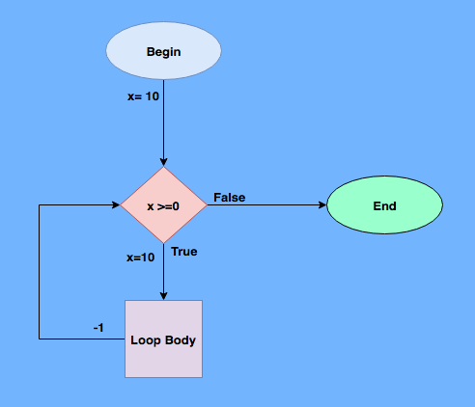
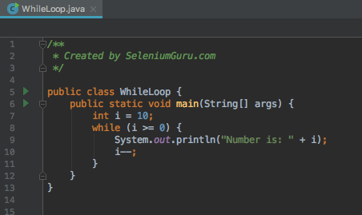
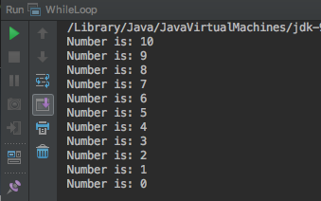
Looping – While Loop

Slide 21
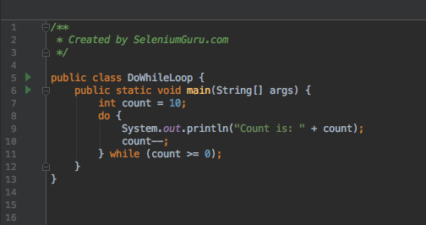
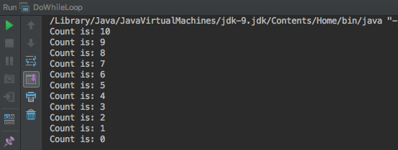
Looping – Do-While Loop

Slide 22
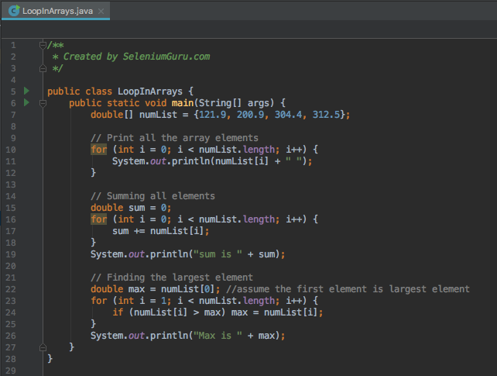
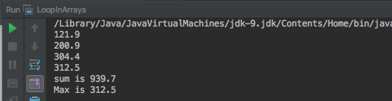
Looping – Arrays

Slide 23
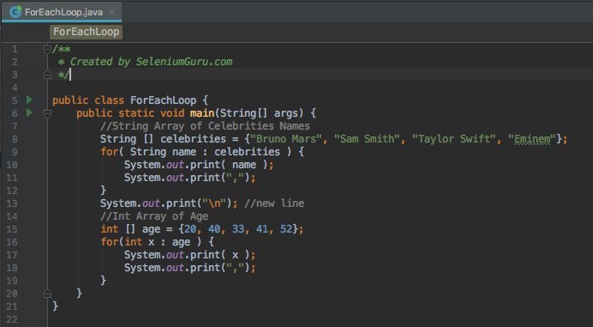
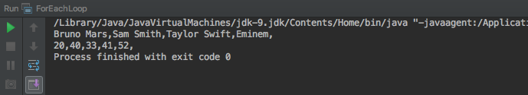
Looping – ForEach

Slide 24
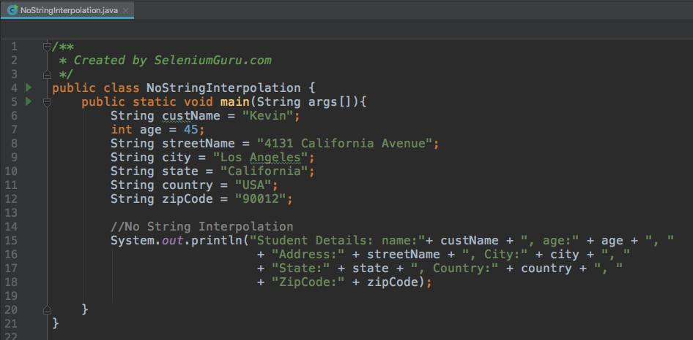
String Interpolation

Slide 25
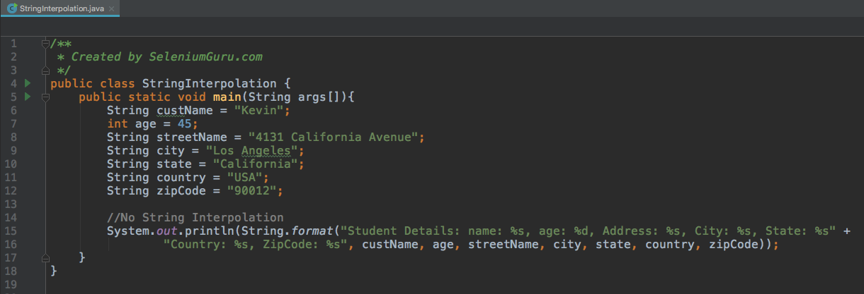
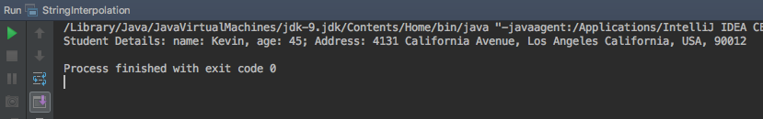
String Interpolation

Slide 26
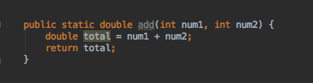
Methods
Methods are collection of statements grouped together to perform an operation.
Methods are used to bundle one or more repeatable statements into a single unit.
Methods are very similar to functions in any other programming language.
Example:
System.out.println(3 + 2) = 5
System.out.println(4 + 5) = 9
System.out.println(12 + 12) = 44
public static = access modifier
double = return type
add = method name
num1 = int parameter1
num2 = int paramter2

Slide 27
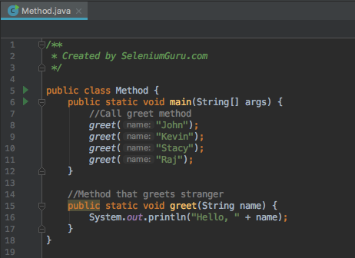
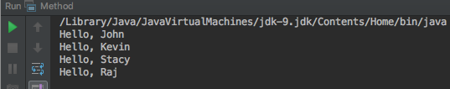
Methods with Return Types – Void(No return)

Slide 28
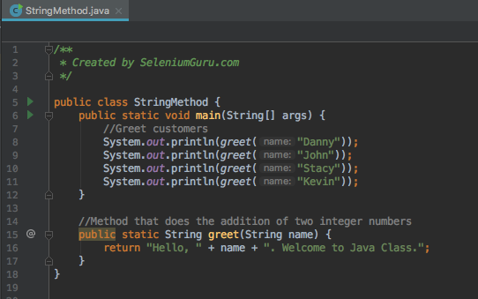
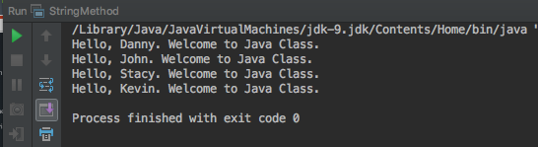
Methods with Return Types- String

Slide 29
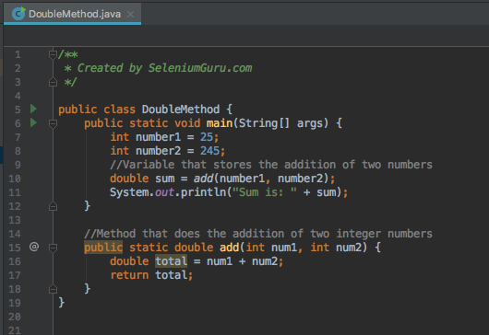
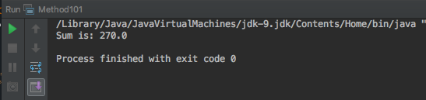
Methods with Return Types - Double

Slide 30
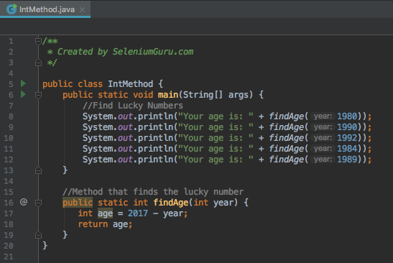
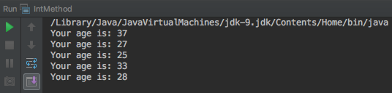
Methods with Return Types- Int

Slide 31
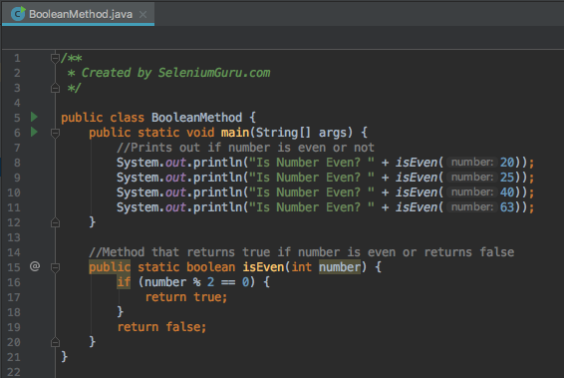
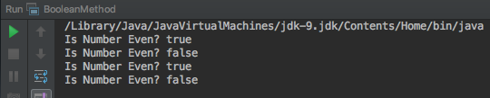
Methods with Return Types - Boolean

Slide 32
Classes
Class is a specification or a blue print (set of instructions) of how to provide some service.
Like Blueprint, Class has some exact specifications.
Many Objects can be created from the same class.
Classes can contain methods, variables for an object.
A class can have subclasses that can inherit all or some of the characteristics of the class.
Subclasses can also define their own methods and variables that are not part of their superclass.
Example:
Animal – Dog, Cat, Giraffe, Monkey
Vehicle – Car, Bicycle, Motorbike, SUV
Ford – Focus, F-150, Mustang, Explorer, Fiesta
Dog – Corgi, German Shepherd, Labrador
Honda – Accord, Civic, Pilot, CR-V

Slide 33
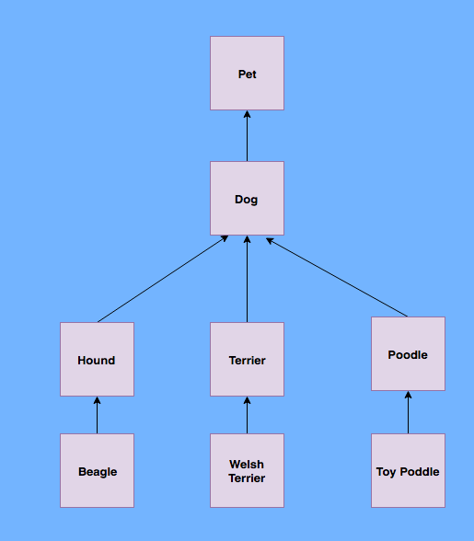


Classes Contd..

Slide 34


Types of Method: Static Method
Static Method: Methods that can be called and executed without creating an object or instantiation of the main class.
Can be invoked directly via class name.

Slide 35


Types of Method: Instance Method
Instance Method: Methods that are called after instantiation of class or object creation.
It is the most Commonly used method type.

Slide 36

Types of Method: Constructor Method
Constructor Method: Default method of the class that will be run at the time when the object is created or instantiated.
Constructor method is used to declare default behavior for all objects.
Constructor name must be same as its class name.
Constructor must have no explicit return type.
There are two types of constructors:
Default constructor (no-arg constructor)
Parameterized constructor

Slide 37


Types of Method: Constructor Method

Slide 38


Types of Method: Constructor methods(parameters)

Slide 39
Types of Method: Accessor (Getter) Method
Accessor Method: Accessor methods provide access to an object's instance variables.
Accessor method is used to return the value of a private field. It follows a naming scheme prefixing the word "get" to the start of the method.
Also called as “Getter” Method is used to get the value from the private variables used in the object.

Slide 40


Types of Method: Accessor Getter Method

Slide 41
Types of Method: Mutators (Setter) Method
Mutators Method: Accessor methods provide access to an object's instance variables.
A mutator method is used to set a value of a private field.
It follows a naming scheme prefixing the word "set" to the start of the method name

Slide 42


Types of Method: Mutator Setter Method

Slide 43
Variables
Variables are the memory locations which holds any data to be used by any program.
Variable Types
Local Variables
Instance Variables
Class Variables
Constants

Slide 44

Local Variables
Variables that are declared in methods, constructors, or blocks.
Local variables are visible only within the declared method, constructor or block.

Slide 45
Instances Variables
Instance variables are declared in a class, but outside a method, constructor or any block.
Instance variables are created when an object is created with the use of the keyword 'new' and destroyed when the object is destroyed.
The instance variables are visible for all methods, constructors and block in the class. Normally, it is recommended to make these variables private (access level).
Instance variables can be accessed directly by calling the variable name inside the class.

Slide 46

Instance Variables

Slide 47
Class Variables
Class variables also known as static variables are declared with the static keyword in a class, but outside a method, constructor or a block.
Static variables are rarely used other than being declared as constants. Constants are variables that are declared as public/private, final, and static. Constant variables never change from their initial value.
Static variables are stored in the static memory. It is rare to use static variables other than declared final and used as either public or private constants.
Static variables are created when the program starts and destroyed when the program stops.
Visibility is similar to instance variables. However, most static variables are declared public since they must be available for users of the class.

Slide 48


Class Variables

Slide 49


CONSTANTS
Variables that is permanent/immutable.
Always written in uppercase.
Always denoted by final return type.

Slide 50
Packages
A java package is a group of similar types of classes, interfaces and sub-packages.
Package in java can be categorized in two form, built-in package and user-defined package.
There are many built-in packages such as java, lang, awt, javax, swing, net, io, util, sql etc.
Advantage of Java Package
Java package is used to categorize the classes and interfaces so that they can be easily maintained.
Java package provides access protection.
Java package removes naming collision.

Slide 51


Packages

Slide 52
String Methods
The java.lang.String class provides many useful methods to perform operations on sequence of char values.
Common String Methods
length() - returns the length of string
format(String s) – returns formatted string
substring(int index) – returns substring for given begin index.
substring(int beginIndex, int endIndex) – returns substring starting from begin index and end index.
contains(Char c) – returns true or false after matching the sequence of char value.
equals(String) – check the equality of string with object.
equalsIgnoreCase(String) – Compares another string.
isEmpty() – checks if string is empty.

Slide 53


String Methods Contd..

Slide 54
String Methods Contd..
Common String Methods
concat(String s) – concatenates specified string.
replace(Char a, Char b) – replaces all occurrences of specified char value.
split(String regEx) – returns splitted string matching regex.
toLowerCase()- returns string in lowercase.
toUpperCase()- returns string in uppercase.
trim() – removes beginning and ending spaces of this string.
valueOf(int value) – converts given type into string.

Slide 55


String Methods Contd..

Slide 56
Integer Methods
Int is primitive type which stores the actual binary value for the integer you want to represent whereas Integer is a Java class and variables of Integer stores references to Integer objects, just as with any other reference (object) type.
Common Integer Methods
intValue() – returns integer value of integer class object.
doubleValue()– returns double value of Integer.
floatValue() – returns float value of Integer.
parseInt()- returns integer value of String if applicable.
compare(int d) – compares 0 if integer a and integer b is equal.
equals(String) – check the equality of string with object.

Slide 57


Integer Methods Contd..

Slide 58
Regular Expressions
Regular expression (regex or regexp for short) is a special text string for describing a search pattern.
Regex pattern are normally described inside the ”\”
Example: wildcard notations such as “\\*.txt” to find all text files in a file manager.
RegEx Character | Meaning
^ | Beginning of string
$ | End of string
. | Any character
* | Match 0 or more times
+ | Match 1 or more times
? | Match 0 or 1 time
| | alternative
() | Grouping
[] | Match any string inside the square bracket
{} | Repetition modifier
\ | Escape(turn RegEx in plain character)
\w | Any word character
\d | Any digit

Slide 59


Regular Expressions

